Slide 2
DVD
Let’s watch a DVD…
9-2
Notes:
Instructor Notes
Play the “Sanitary Facilities and Equipment” section from the Facilities, Cleaning and Sanitizing, and Pest Management DVD.

Slide 3
Additional Content
Some other things you should know…
9-3
Notes:
Instructor Notes
Teach the additional content not included in the section of the DVD just watched by using the next several PowerPoint slides.

Slide 4
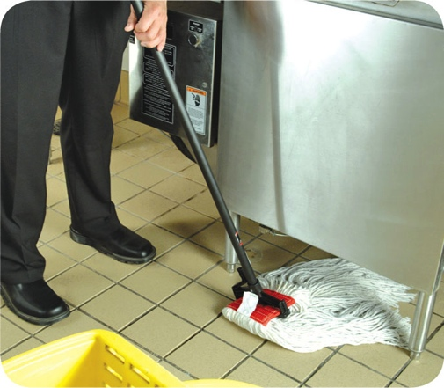
Interior Requirements for a Safe Operation
Floors, walls, and ceilings:
Materials must be smooth and durable for easier cleaning
Must be regularly maintained
9-4
Notes:
Instructor Notes
Once installed, flooring, walls, and ceilings must be regularly maintained. Replace missing or broken ceiling tiles. Do the same for flooring. Repair all holes in walls.

Slide 5
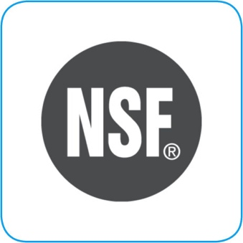
Equipment Selection
Foodservice equipment must meet these standards if it will come in contact with food:
Nonabsorbent, smooth, and corrosion resistant
Easy to clean
Durable
Resistant to damage
9-5
Notes:
Instructor Notes
Foodservice equipment must meet certain standards if it will come in contact with food.
NSF is an organization that creates these national standards. NSF is accredited by the American National Standards Institute (ANSI).
NSF/ANSI standards for food equipment require that it be nonabsorbent, smooth, and corrosion resistant. Food equipment must also be easy to clean, durable, and resistant to damage.

Slide 6
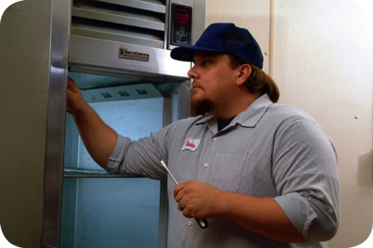
Installing and Maintaining Equipment
Once equipment has been installed:
It must be maintained regularly
Only qualified people should maintain it
Set up a maintenance schedule with your supplier or manufacturer
Check equipment regularly to make sure it is working correctly
9-6

Slide 7
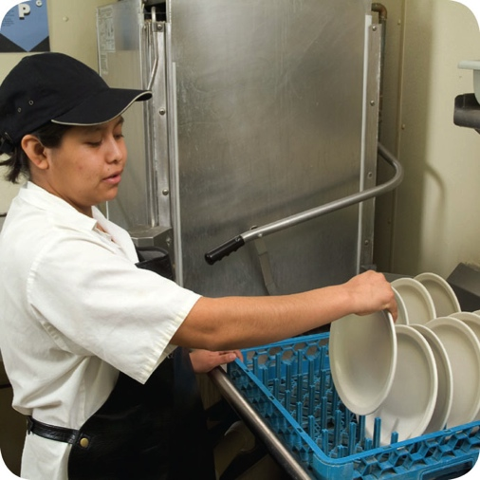
Dishwashing Machines
Dishwashers must be installed:
So they are reachable and conveniently located
In a way that keeps utensils, equipment, and other food-contact services from becoming contaminated
Following manufacturer’s instructions
9-7
Notes:
Instructor Notes
Always follow the manufacturer’s instructions when installing, operating, and maintaining dishwashers.

Slide 8
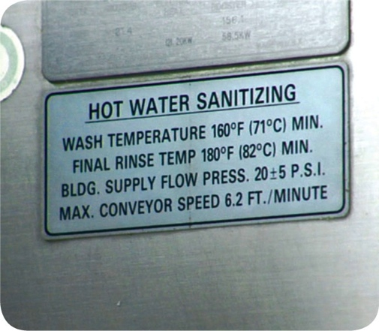
Dishwashing Machines
When selecting dishwashers make sure:
The detergents and sanitizers used are approved by the local regulatory authority
They have the ability to measure water temperature, water pressure, and cleaning and sanitizing chemical concentration
Information about the correct settings is posted on the machine
9-8

Slide 9
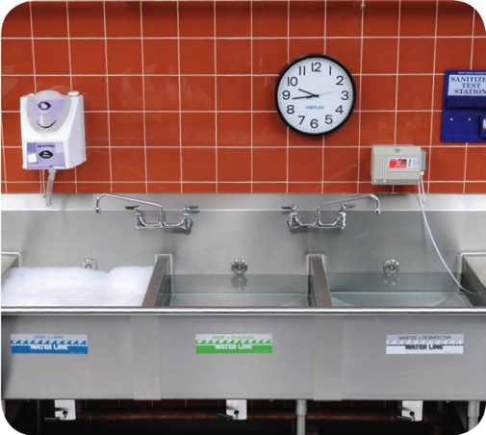
Three-Compartment Sinks
Purchase sinks large enough to accommodate large equipment and utensils.
9-9
Notes:
Instructor Notes
You should also have other methods for cleaning these items.

Slide 10
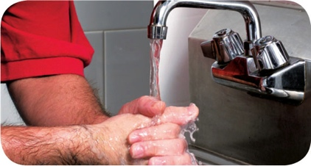
Handwashing Stations
Handwashing stations must be conveniently located and are required in:
Restrooms or directly next to them
Food-prep areas
Service areas
Dishwashing areas
Handwashing sinks must be used only for handwashing.
9-10
Notes:
Instructor Notes
Handwashing stations should be put in areas that make it easy for staff to wash their hands often. Make sure these stations work correctly and are well stocked and maintained. They must also be available at all times.
Handwashing stations cannot be blocked by portable equipment or stacked full of dirty kitchenware.

Slide 11
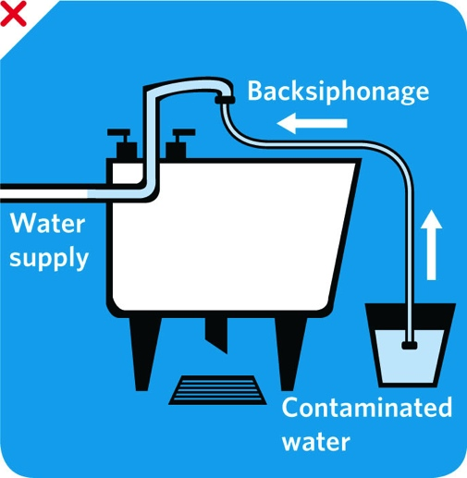
Water and Plumbing
Backflow:
Reverse flow of contaminants through a cross-connection into the drinkable water supply
Backsiphonage:
A vacuum created in the plumbing system that sucks contaminants back into the water supply
Can occur when high water use in one area of the operation creates a vacuum
A running hose in a mop bucket can lead to backsiphonage
9-11
Notes:
Instructor Notes
Backflow can be the result of pressure pushing contaminants back into the water supply. It can also happen when high water use in one area of an operation creates a vacuum in the plumbing system that sucks contaminants back into the water supply. This is called backsiphonage.
A running faucet below the flood rim of a sink is an example of a cross-connection that can lead to backsiphonage. A running hose in a mop bucket is another example.

Slide 12
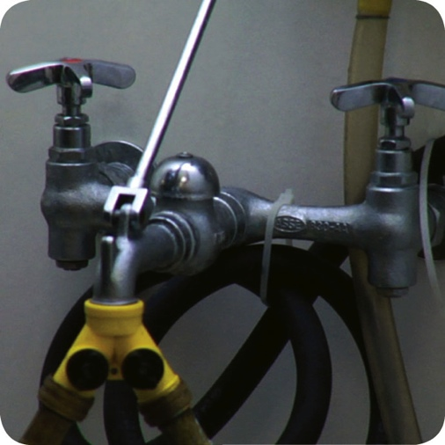
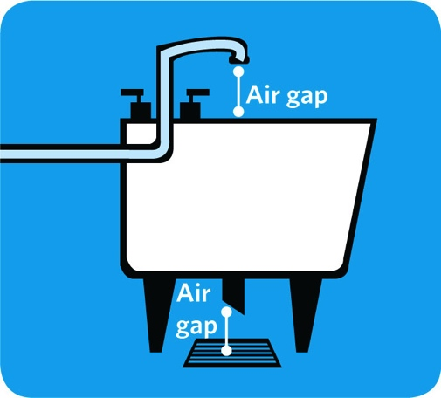
Water and Plumbing
Backflow prevention methods:
Vacuum breaker
Air gap
9-12
Notes:
Instructor Notes
The best way to prevent backflow is to avoid creating a cross-connection. Do not attach a hose to a faucet unless a backflow prevention device, such as a vacuum breaker, is attached. A vacuum breaker is a mechanical device that prevents backsiphonage. It does this by closing a check valve and sealing the water supply line shut when water flow is stopped.
Other mechanical devices are used to prevent backflow. These include double check valve and reduced pressure zone backflow preventers. These devices include more than one check valve for sealing off the water supply. They also provide a way to determine if the check valves are operational.
Backflow prevention devices must be checked periodically to make sure they are working correctly. This work must be done and documented by a trained and certified technician. Always follow local requirements and manufacturer’s recommendations.
The only sure way to prevent backflow is to create an air gap. An air gap is an air space that separates a water supply outlet from a potentially contaminated source. A sink that is correctly designed and installed usually has two air gaps, as shown in the graphic on the slide. One is between the faucet and the flood rim of the sink. The other is between the drainpipe of the sink and the floor drain of the operation.

Slide 13
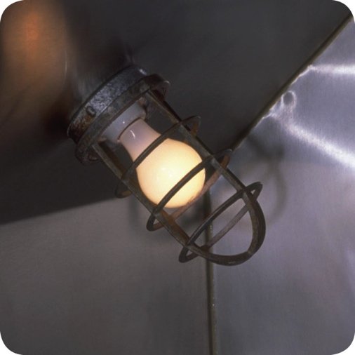
Lighting
Consider the following when installing and maintaining lighting:
Different areas of the facility have different lighting intensity requirements
Local jurisdictions usually require prep areas to be brighter than other areas
All lights should have shatter-resistant lightbulbs or protective covers
Replace burned out bulbs with correct size bulbs
9-13
Notes:
Instructor Notes
Good lighting makes it easier to clean things in your operation. It also provides a safer environment.
Lighting intensity—how bright the lights are in the operation—is usually measured in units called foot-candles or lux. Local jurisdictions usually require prep areas to be brighter than other areas. This allows staff to recognize the condition of food. It also allows staff to identify items that need cleaning.
Once the appropriate level of lighting has been installed in each area of the facility, you must monitor it. Replace any bulbs that have burned out. And make sure they are the correct size. All lights should have shatter-resistant lightbulbs or protective covers. These products prevent broken glass from contaminating food or food-contact surfaces.

Slide 14
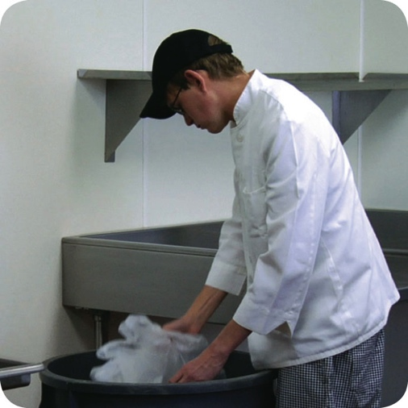
Garbage
Designated storage areas:
Store waste and recyclables separately from food and food-contact surfaces
Storage must not create a nuisance or a public health hazard
9-14
Notes:
Instructor Notes
Waste and recyclables must be stored separately from food and food-contact surfaces. The storage of these items must not create a nuisance or a public health hazard.

Slide 15
Emergencies That Affect the Facility
Imminent health hazard:
A significant threat or danger to health
Requires immediate correction or closure to prevent injury
Possible imminent health hazards:
Electrical power outages
Fire
Flood
Sewage backups
9-15
Notes:
Instructor Notes
Certain crises can affect the safety of the food you serve. Common crisis’ include electrical power outages, fire, flooding, and sewage backups. Local regulatory authorities consider these to be imminent health hazards. An imminent health hazard is a significant threat or danger to health that requires immediate correction or closure to prevent injury.
Temperature control: Power failures and refrigeration breakdowns can threaten your ability to control the temperature of TCS food, which can result in the growth of pathogens.
Physical security: Unauthorized people inside a facility are a risk to food safety. This is especially true when they can access storage and processing areas. Also, acts of nature can weaken a facility’s security.
Drinkable water supply: Threats to the drinkable water supply must also be considered. Broken water mains and breakdowns at water treatment facilities are a risk to the safety of food. Terrorist contamination of the water supply could also be a threat.

Slide 16
Emergencies That Affect the Facility
How to respond to a crisis affecting the facility:
Determine if there is a significant risk to the safety or security of your food
If the risk is significant
Stop service
Notify the local regulatory authority
Decide how to correct the problem
Establish time-temperature control
Clean and sanitize surfaces
Verify water is drinkable
Reestablish physical security of the facility
9-16

Slide 17
Review
Let’s review
9-17
Notes:
Instructor Notes
Review the content presented using the next several PowerPoint slides.
To ensure that everyone in class participates, pass out index cards with the letters A, B, C, and D on them. Have each student answer each question by holding up the correct letter.

Slide 18
Review
What are the most important things to look for when choosing materials for floors, walls, and ceiling?
The smoothness of the materials
The durability of the materials
9-18
Notes:
Instructor Notes
Cleaning will be easier if you choose materials that are smooth and durable.

Slide 19
Review
What standards must equipment food-contact surfaces meet in order to keep food safe?
Nonabsorbent
Smooth
Corrosion resistant
Clean
Durable
Resistant to damage
9-19
Notes:
Instructor Notes
Foodservice equipment must meet certain standards if it will come in contact with food. NSF is an organization that creates these national standards.
NSF is accredited by the American National Standards Institute (ANSI). NSF/ANSI standards for food equipment require that it be nonabsorbent, smooth, and corrosion resistant. Food equipment must also be easy to clean, durable, and resistant to damage.

Slide 20
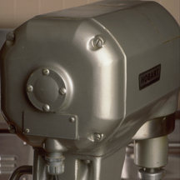
Review
How far should floor-mounted equipment be installed from the floor?
A. 0 inches
B. 2 inches
C. 4 inches
D. 6 inches
Standing mixer
9-20
Notes:
Instructor Notes
The answer is D. Put floor-mounted equipment on legs at least six inches (15 centimeters) high. Another option is to seal it to a masonry base.

Slide 21
Review
What factors must dishwashers have the ability to measure?
Water temperature
Water pressure
Cleaning and sanitizing chemical concentration
9-21
Notes:
Instructor Notes
Information about the correct settings should be posted on the machine.

Slide 22
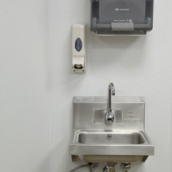
Review
What’s missing from this handwashing station?
9-22
Notes:
Instructor Notes
The handwashing station appears to be missing signage that reminds employees to wash their hands before returning to work. That signage should be in all languages used by the staff in the operation.
It also appears to be missing a garbage container for disposing of paper towels used to dry hands.

Slide 23
Review
How can backflow be prevented?
Avoid creating a cross-connection
Install a backflow prevention device
Create an air gap
9-23
Notes:
Instructor Notes
The best way to prevent backflow is to avoid creating a cross-connection. Do not attach a hose to a faucet unless a backflow prevention device is attached.
A vacuum breaker is a mechanical device that prevents backsiphonage. It does this by closing a check valve and sealing the water supply line shut when water flow is stopped.
Other mechanical devices are used to prevent backflow. These include double check valve and reduced pressure zone backflow preventers. These devices include more than one check valve for sealing off the water supply. They also provide a way to determine if the check valves are operational.
The only sure way to prevent backflow is to create an air gap. An air gap is an air space that separates a water supply outlet from a potentially contaminated source.

Slide 24
Review
What can be done to keep garbage from contaminating food and equipment?
Remove it from prep areas quickly
Clean garbage containers frequently
Purchase leak proof, waterproof, and pest proof containers
Cover containers when not in use
Store waste and recyclables separately from food and food-contact surfaces
Make sure outdoor containers have tight-fitting lids and keep them covered
9-24

Slide 25
Review
What should be done if there is a sewer backup in the facility?
Determine if there is a significant risk to the safety or security of food
Stop service if the risk is significant
Notify the local regulatory authority
9-25
Notes:
Instructor Notes
Certain crises can affect the safety of the food you serve. Some of the most common include electrical power outages, fire, flooding, and sewage backups. These are considered by the local regulatory authority to be imminent health hazards. An imminent health hazard is a significant threat or danger to health that requires immediate correction or closure to prevent injury.
When faced with any of these crises, you must first determine if there is a significant risk to the safety or security of your food. If the risk is significant, service must be stopped. Then the local regulatory authority must be notified.

Slide 26
Activity
Pests vs. PCO’s…
9-26
Notes:
Instructor Notes
This activity can be downloaded from ServSafe.com. Directions for using the activity are included with it.

